Slide 1
Intune Suite: The One-Stop-Shop for Endpoint Management
Jens Du Four

Slide 2




Jens Du Four
Cloud Endpoint TS @ Microsoft
Traveler/Musician/Beekeeper/…

Slide 3
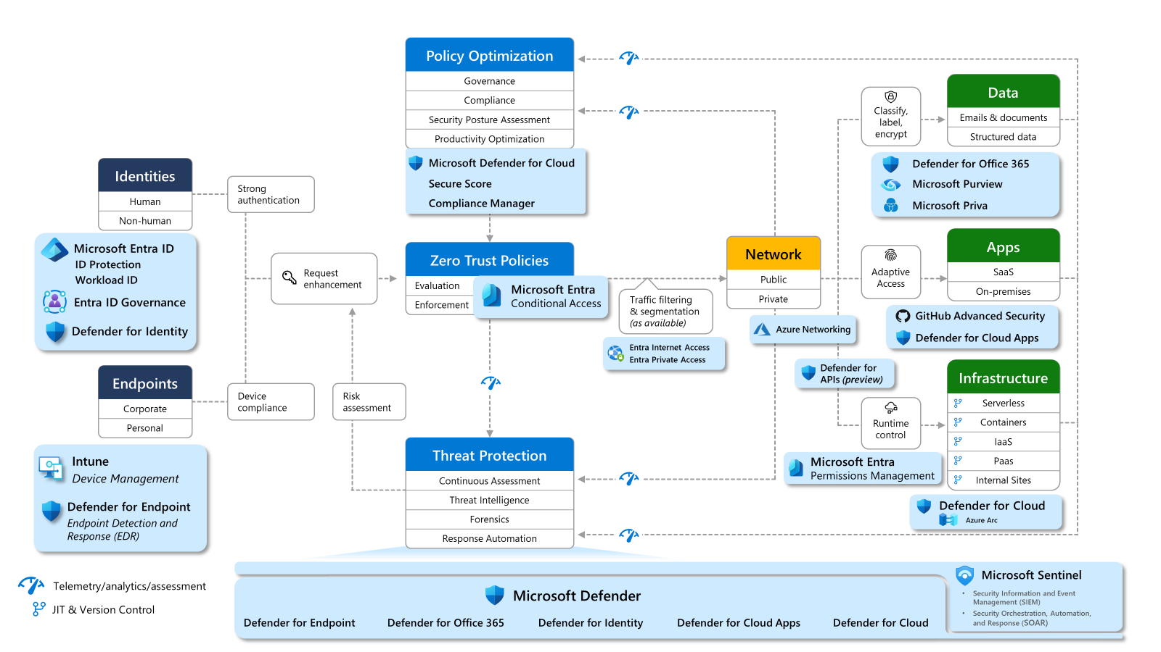

Slide 4

Cloud PKI
Device Query
Remote Help
Enterprise Application Management
Intune Suite
Advanced Endpoint Analytics
Remediations
Tunnel for MAM
Security Copilot
Platform SSO
Autopilot V2
Windows 365

Slide 5
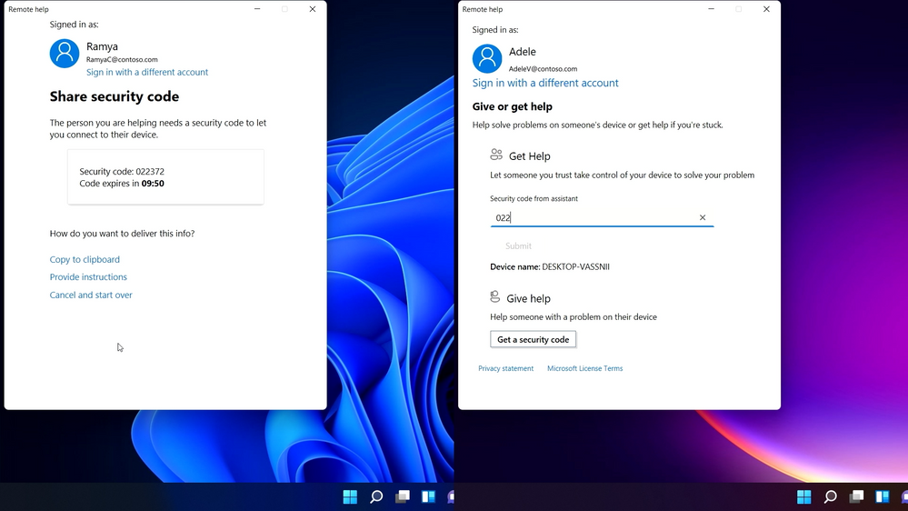
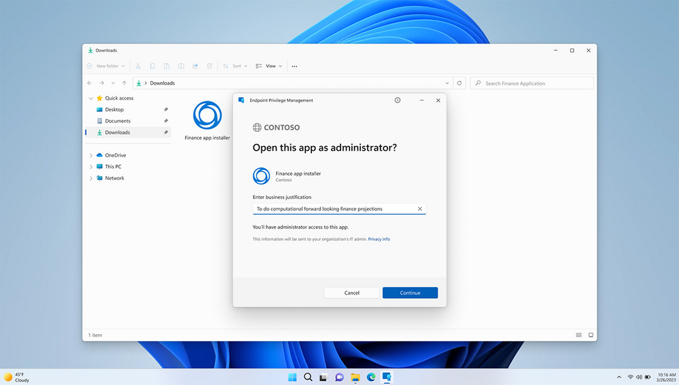
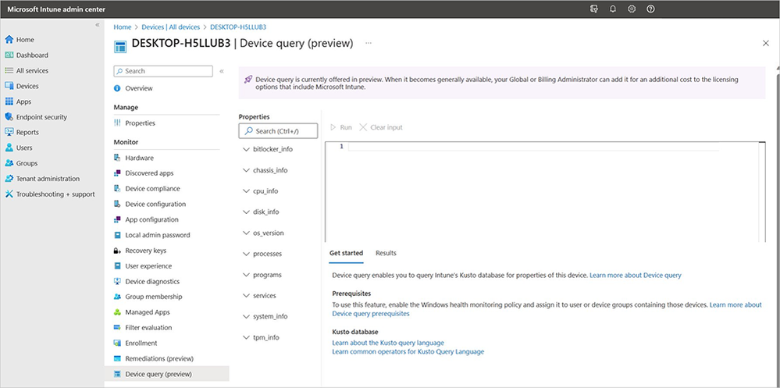
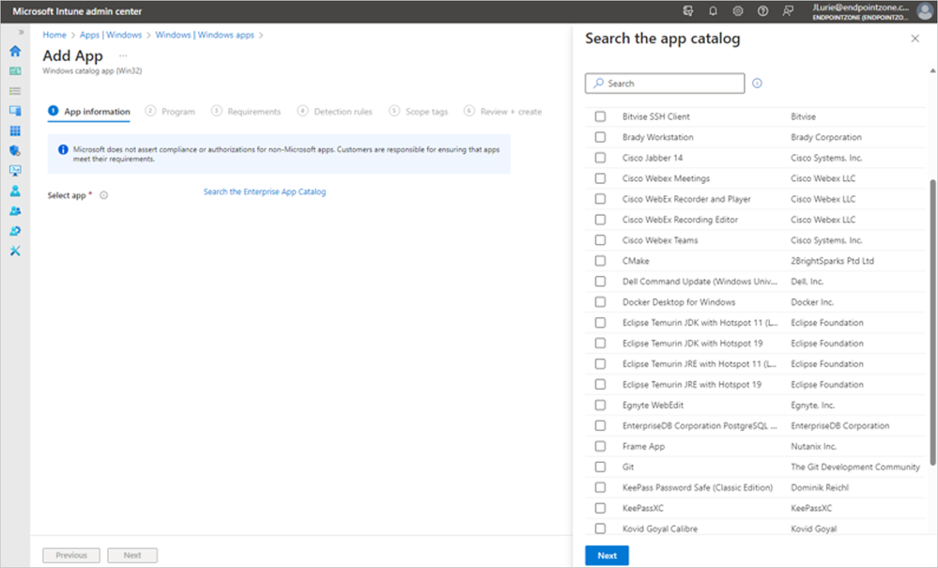
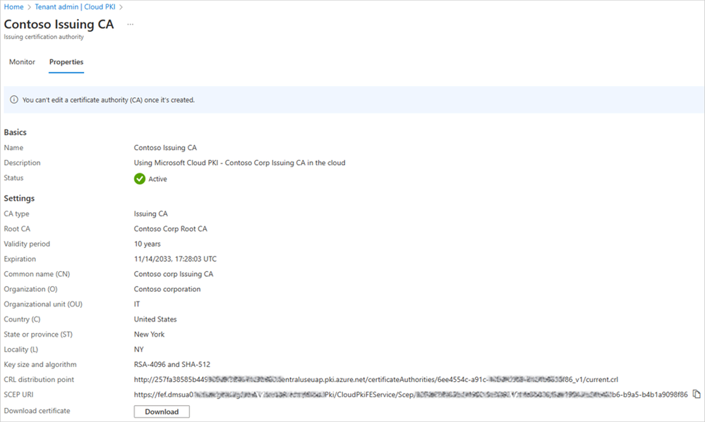

Slide 6
Remote Help
Windows
Disable chat at the tenant level​
Show reasons for non-compliance prior to accessing device​
Annotation tool enhancement and laser pointer​
Intune audit logs that show who helped whom​ and can be exported
Full threaded chat experience​
Conditional access (e.g., MFA) ​
Switch from view-only to full control during session
ARM64, Windows 365 support
Launch a session seamlessly from Intune
macOS
Full control support
Threaded chat and Intune audit logs
Conditional access
Session reporting history
Android
Attended/Unattended
Session reporting history
Intune audit log

Slide 8
Endpoint Privilege Management
Automatic, user-confirmed or support-approved elevation
Insights based on elevation audits
Effective control of child processes
Rules based on organizational requirements
Easy addition or removal of rules
Tenant level enablement, per device rollout

Slide 10
Cloud PKI
Create certification authorities per Intune tenant
Create 2-tier PKI hierarchy
Root, issuing CA in the cloud
Support Bring Your Own CA (BYOCA)
Anchor Intune issuing CA to a private CA
Signing and encryption algorithms | RSA
RSA Key sizes – 2048, 3072, 4096
Hash algorithms – SHA-256, SHA-384, SHA-512
Providing a Cloud Certificate Registration Authority (SCEP) service per issuing CA
CRL distribution points
End-entity (leaf) certificate issuance
Protocol/Cert format – SCEP (PKCS#7)
Platforms: Intune-enrolled devices on iOS, Android, Mac, and Windows
Certificate life cycle management
Automatic and manual certificate revocation
Reporting/Dashboard
Issuing CA summary (issued, expired, revoked) and detailed information about issued certificates
Audit
Admin actions performed on the CA (i.e., create, disable, delete, renew, revoke)
RBAC permissions and scope tags

Slide 12
Advanced Endpoint Analytics
Identify anomalies based on patterns of unexpected events and signals aggregated across enrolled devices.
Discover meaningful patterns and trends by correlating anomalies to device configurations and properties like OS version and app/driver versions.
Use an enhanced device timeline view that includes anomalies to ease and speed troubleshooting.
Get detailed report of the analytics, insights, and recommendations for a subset of devices using IT-defined scope tag.
Device inventory querying for near real-time assessment of the state of devices and taking action.
Battery health insights to support sustainability goals while enabling remote work, device longevity, and improved hardware purchase decisions.

Slide 14
Enterprise Application Management
Securely hosted Enterprise App Catalog for Microsoft and non-Microsoft applications
Prepackaged and preconfigured apps
No wrapping, no install commands
Includes Microsoft-hosted and validated content

Slide 16
Q&A

